Slide 1
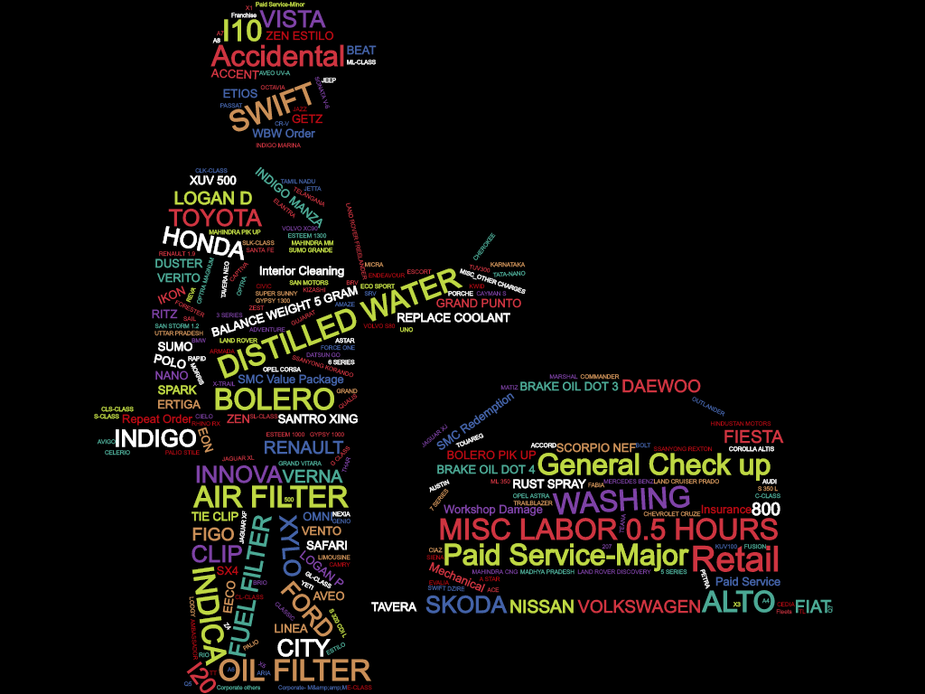

Mahindra First Choice – Capstone Project
Team – GreyElectrons
Team Member - 1) Ashwin Tiwari
2) Iftekar Patel
3) Rizwan Alwi
4) Surojit Nath

Slide 2
Problem Statement
Problem Statement – 1 : Identifying the below patterns across all MFCS.
Ownership - Areas having most cars, most popular make/car etc.
Spending - Most Popular services availed.
Problem Statement – 2 : Identify Seasonal and Regional Pattern.
Seasonal - Service is seasonal or mandatory ?
Regional - Difference in each service/labor costing region wise
Problem Statement – 3 : Market Segmentation
Cluster as per Make , Model , Order Type , Average Revenue for target oriented marketing.
Pain point identification for organization(One Timer).
Problem Statement – 4 : Prediction of CLV (Customer Life Time Value).
Stake Holder : 1. CTO and CXO
2. Marketing Team
3. Sales Team
4. Engagement Team

Slide 3
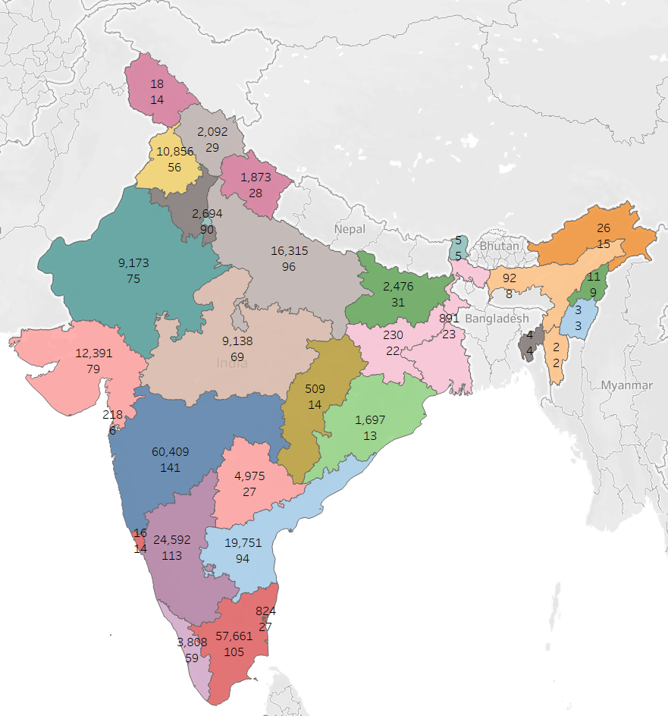
EDA (Exploratory Data Analysis)
Insight :
Tamil Nadu and Maharashtra has maximum of customer and number of plant as compare to other state.
Recommendation :
Need to focus on Northern and Eastern Part of India. Customer count is less as compare to other parts of India.
Interactive dashboard : https://public.tableau.com/profile/surojit3521#!/vizhome/Mahindra-first-choice-final-workbook/CustomerandPlantcountstatewise
Interactive dashboard for Top 20 Country and Make : https://public.tableau.com/profile/surojit3521#!/vizhome/Mahindra-first-choice-final-workbook/StateandMakeRelation
Total Customers : 2,53,485

Slide 4
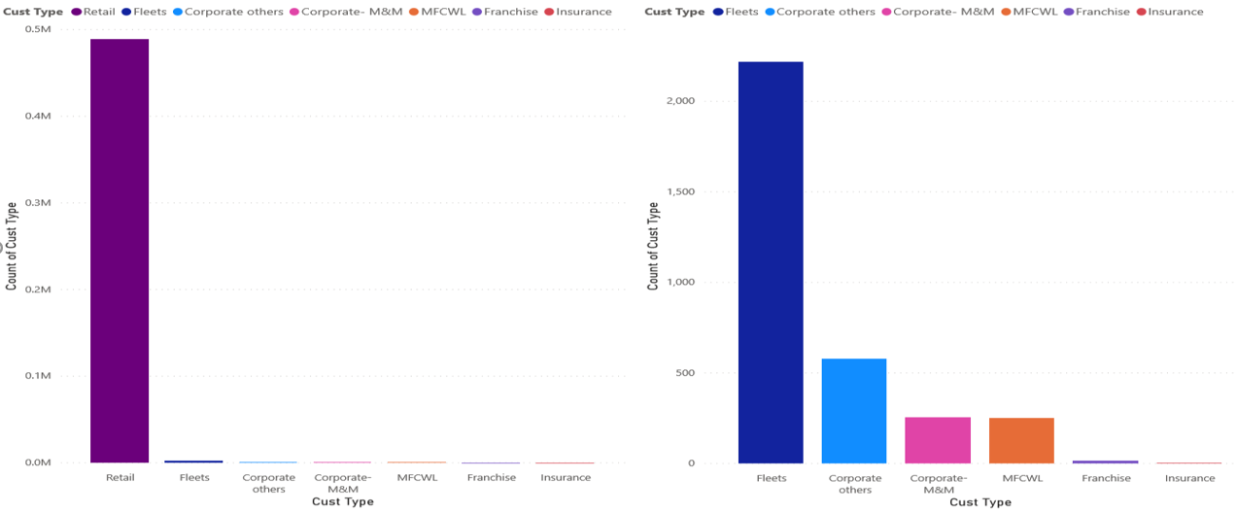
QN : What are the different types of customers ?
Insight : Retail customers dominate followed by Fleets , Corporate-M&M etc.
Recommendation : Need to focus on acquire new franchise also increase the Camping in corporate sector

Slide 5
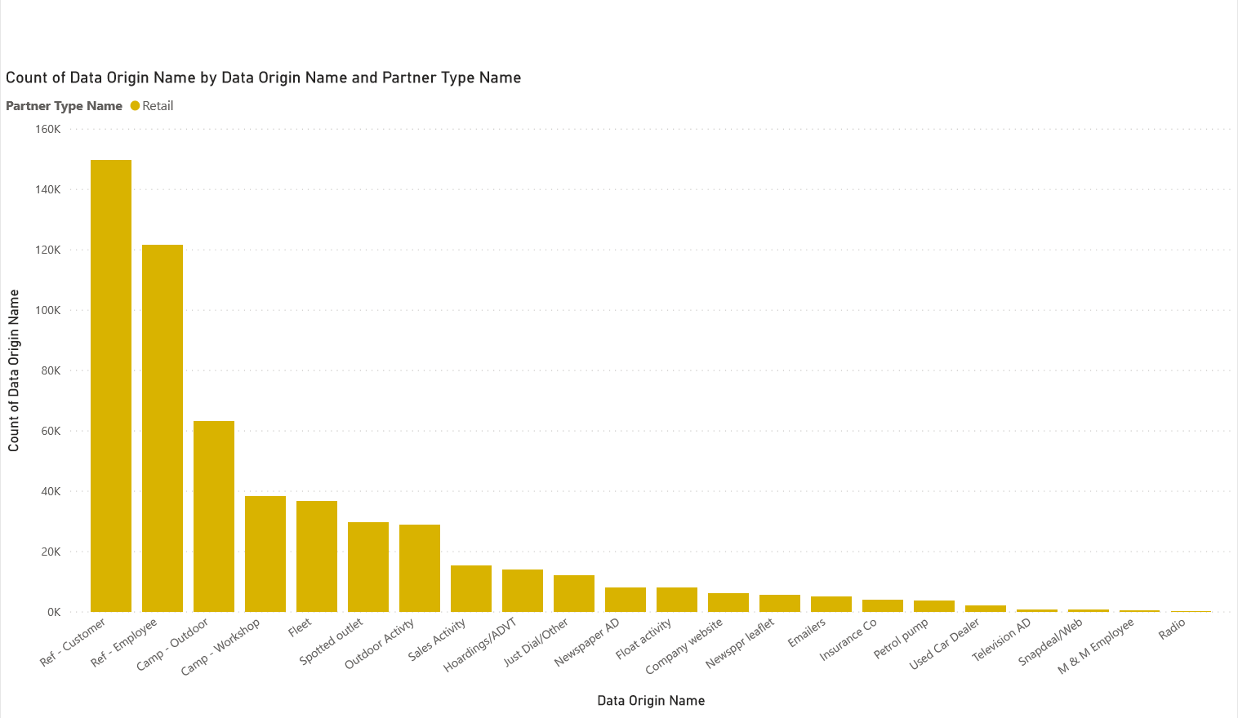
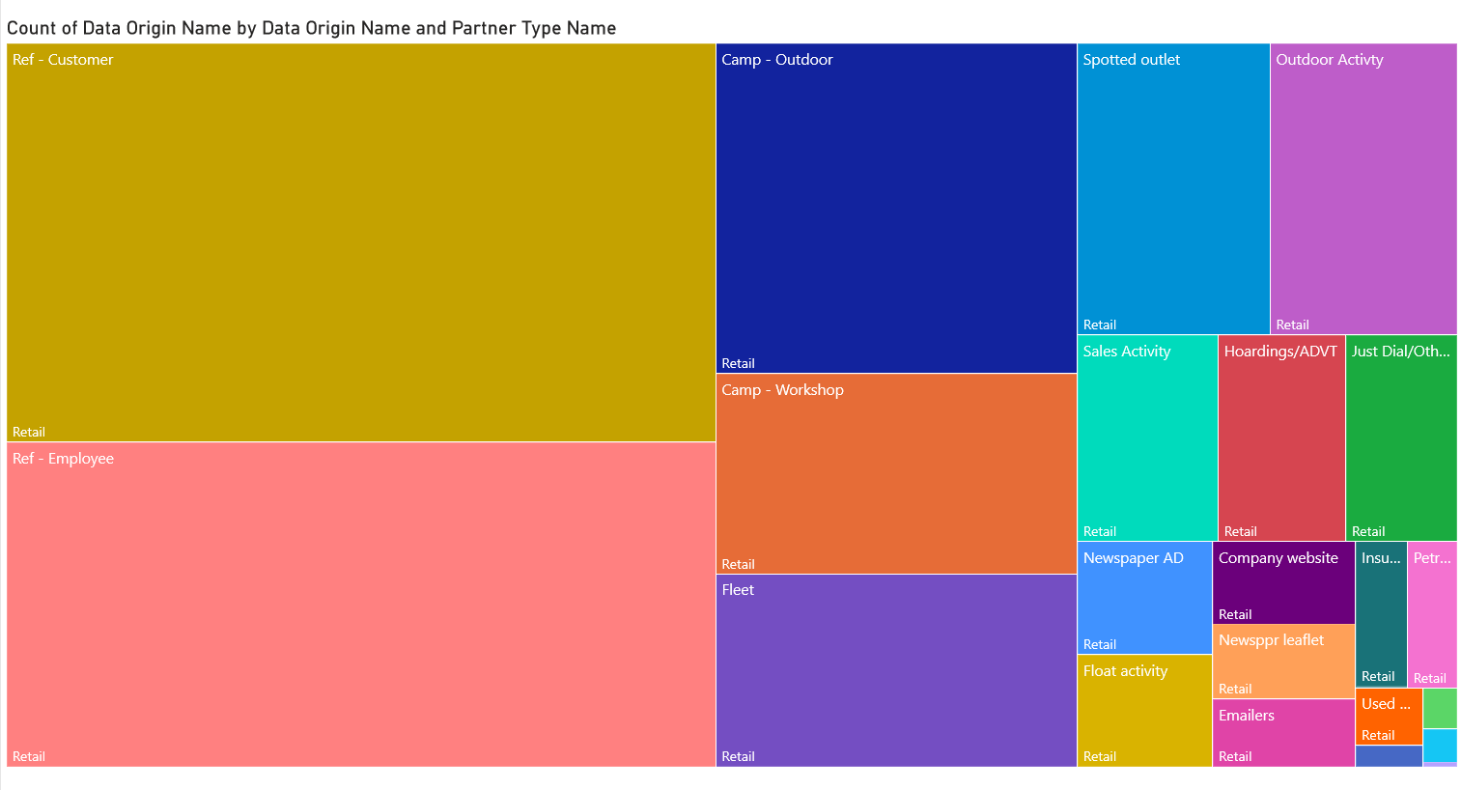
QN : Different sources from where the business comes from.i.e(Customer sources)
Insight : Retail(Z005-Referal by Customer, Z001-Outdoor Camp) , Corporate(Z006-Referal by Employees), Fleet(Z004-Referal by Fleets)
Recommendation : Need to focus more on other data origins.i.e Customer Resources(TV,Radio,Website.etc)

Slide 6
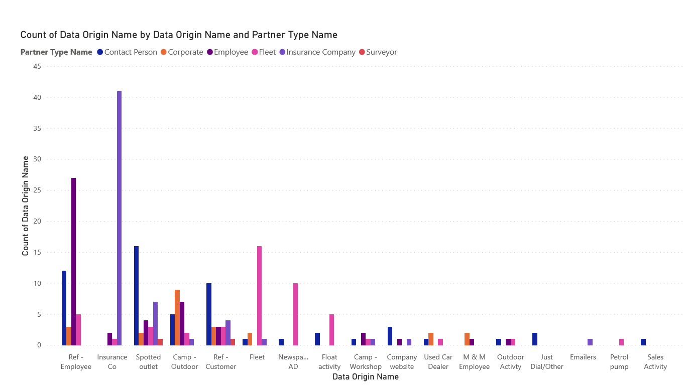

Slide 7
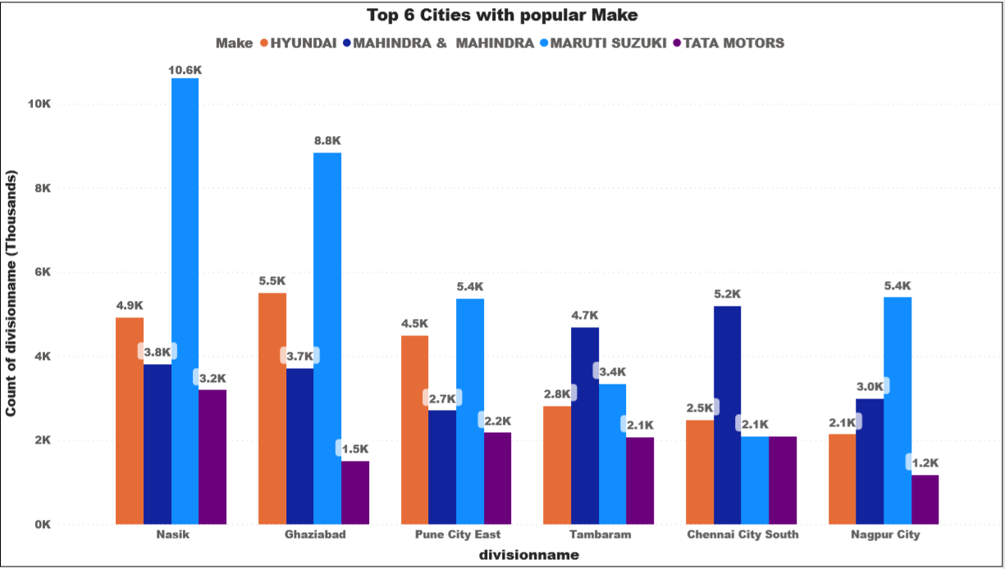
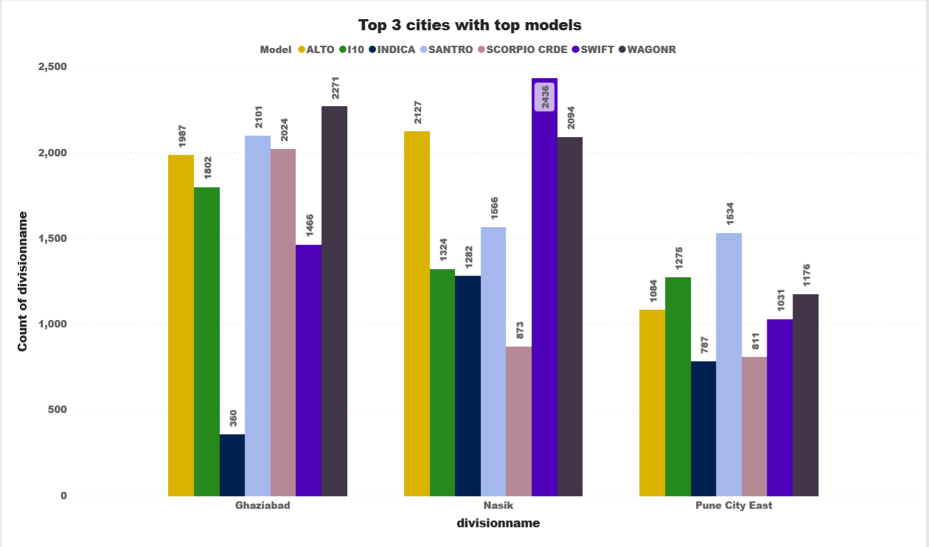
QN1 : Which areas have most cars?
QN2 : Which make/car is more popular?
Insight1 : Nashik has the most car brand(Make) Maruti is dominating the most.
Insight2 : Swift is the most popular model amongst all.
Recommendation : Need to focus on metropolitan cities.
Need to focus on other imported brand as the count of customer is less.

Slide 8
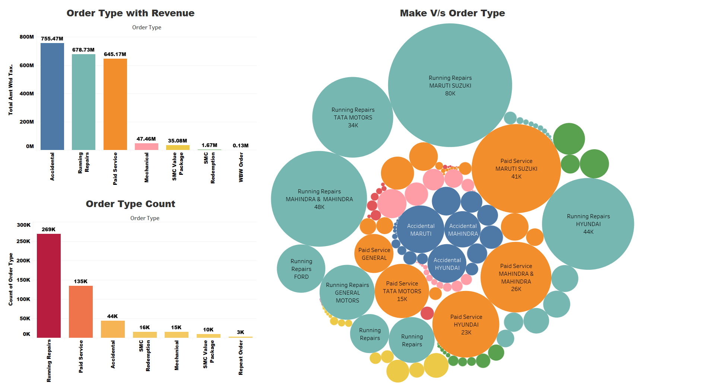
QN : Which is the most used service structure for particular make/car?
Insight : Running Repairs services are more frequent but accidental services generate more revenue.
Maruti, Mahindra and Tata are leading in Running repairs followed by Paid services.
Recommendation : Hassle free claim process for accidental service

Slide 9
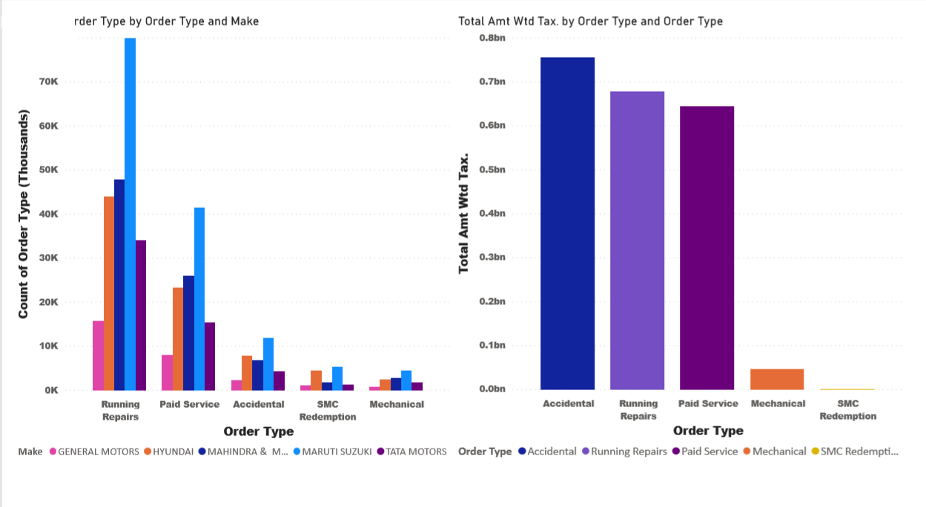
QN : Which service is popular regarding a certain make/car?
Insight : As Running Repairs services are more frequent but accidental services generates more revenue.
Maruti, Mahindra, Tata is leading in running repairs followed by paid services.

Slide 10
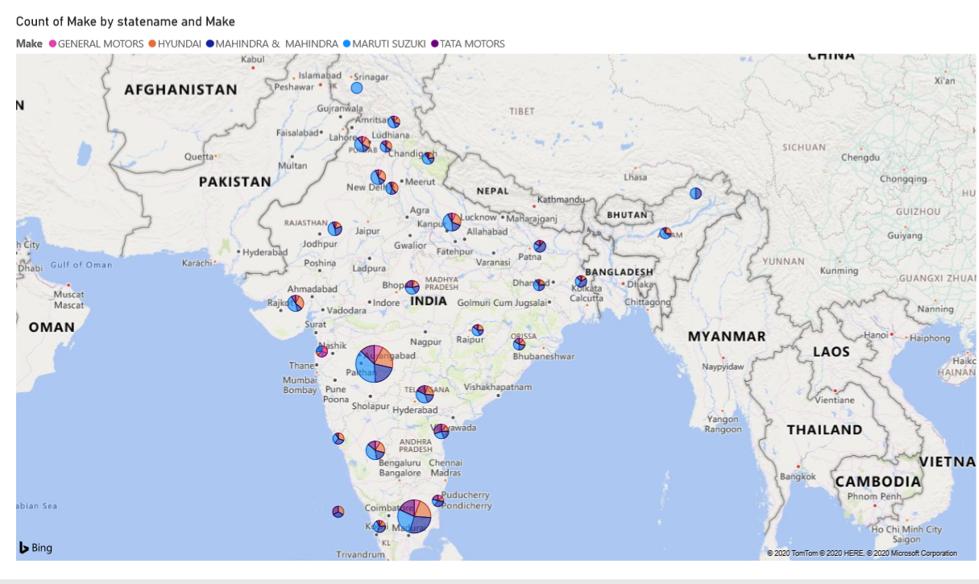
Bird view of state and Make
Insight : Top make in Maharashtra – Maruti, and in Tamil Nadu - M&M.

Slide 11
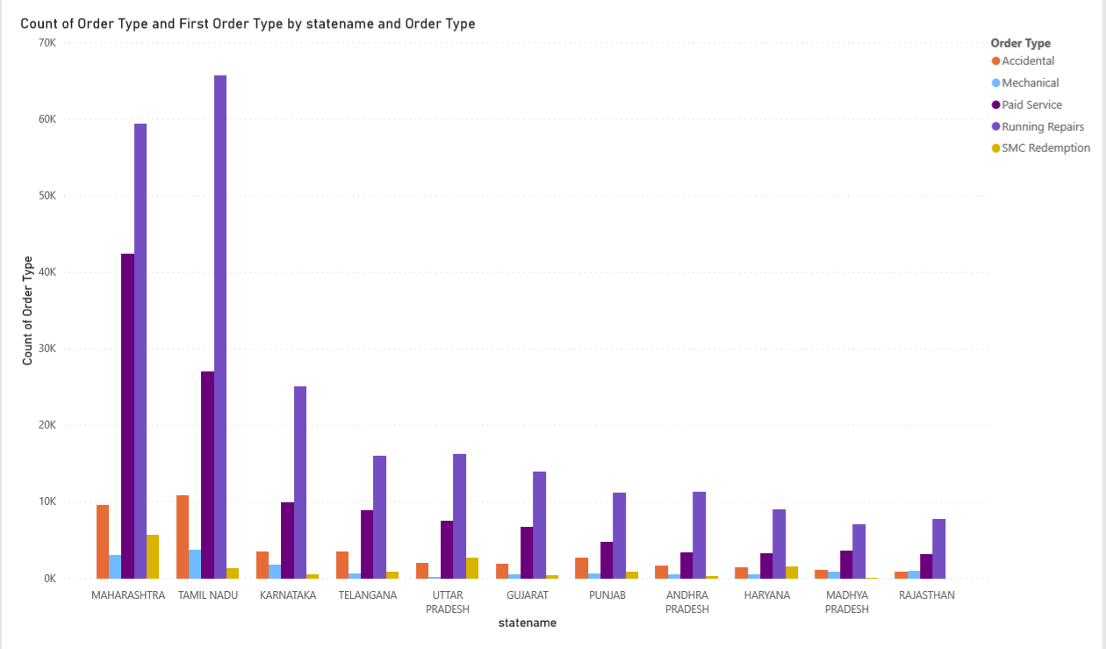
QN : Popular Services : repairs or maintenance?
Insight : Maharashtra, Tamil Nadu and Karnataka has topped in-taking (Running Repair Dominating)
Recommendation : South India is the top most to generate more in-taking services Mahindra should focus on North and Central India

Slide 12
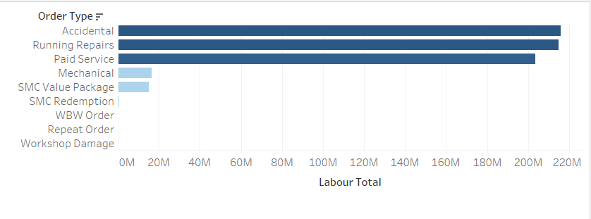
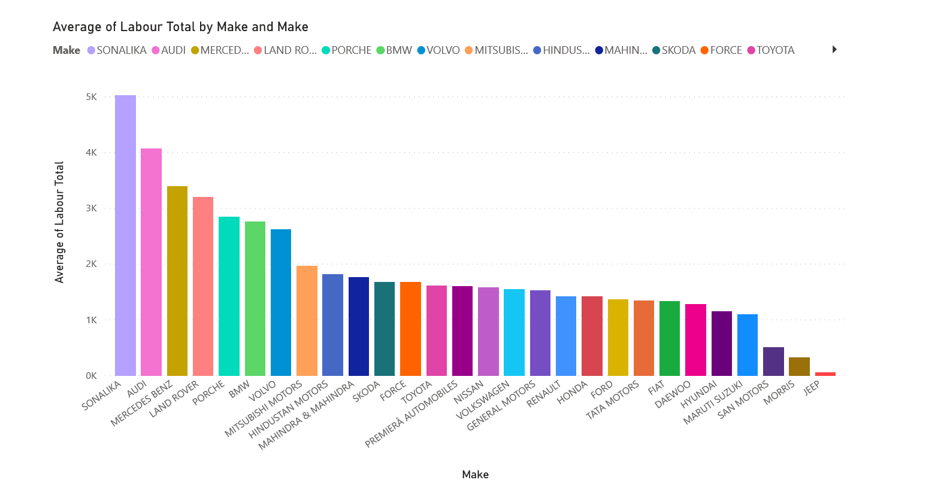
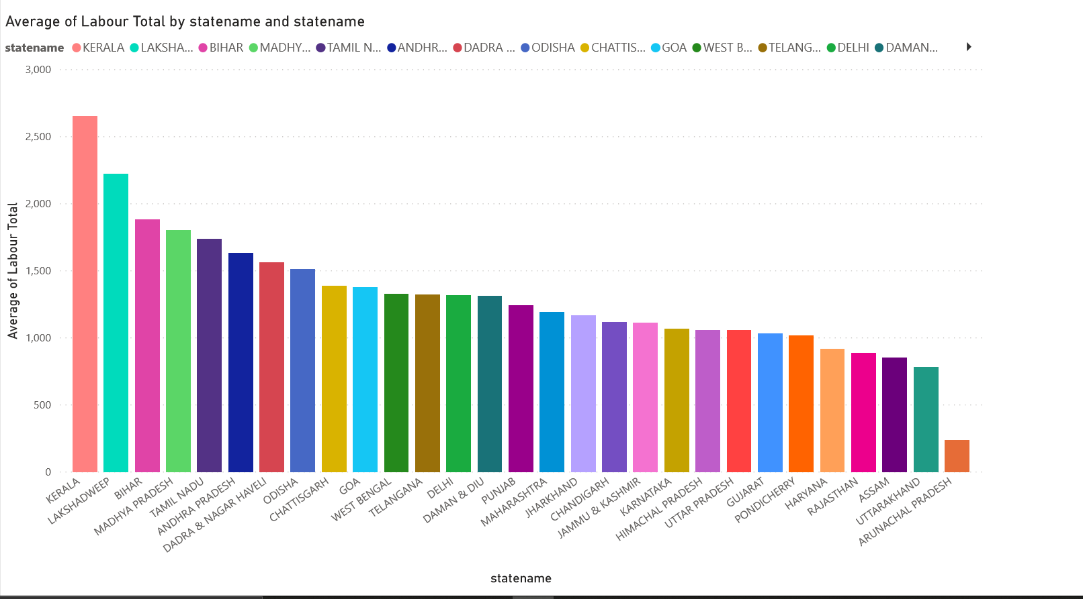
QN : What is the difference in each service/labor costing?
Insight 1 : Highest labor charges are for accidental and Running repair.
Insight 2 : Strangely sonalika has more avg labor cost compared to other luxury car as well as premium.
Insight 3 : Strangely Kerala has more avg labor cost as compared to other states (accidental avg labor is 10k).
Recommendation :
Competitive pricing for premium car services.
Hiring of skilled Labour should be done to provide faster service

Slide 13
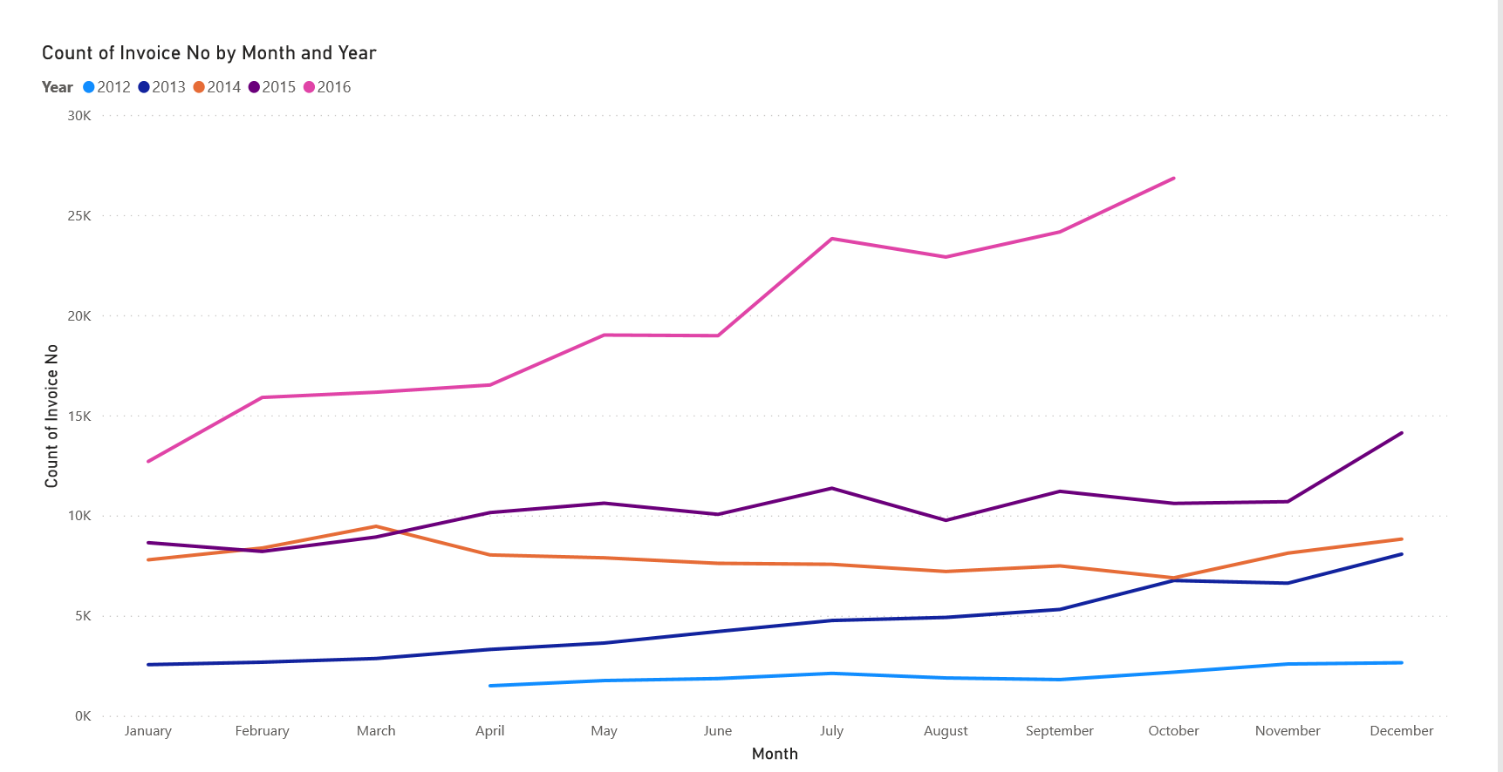
QN : Is the service seasonal or regular?
Insight : Pattern describes that monsoon and year ending month is seasonal.
Recommendation : Inventory should be maintain for 2nd half of a year.
Seasonal promotion offer

Slide 14
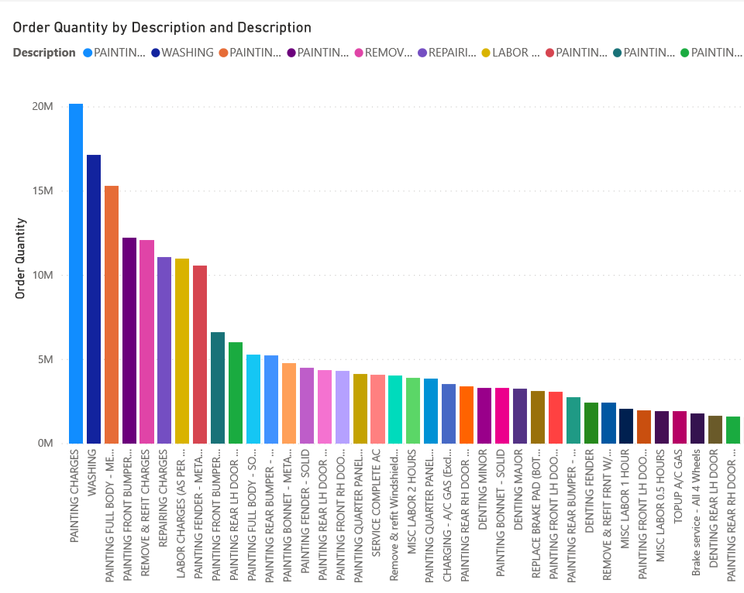
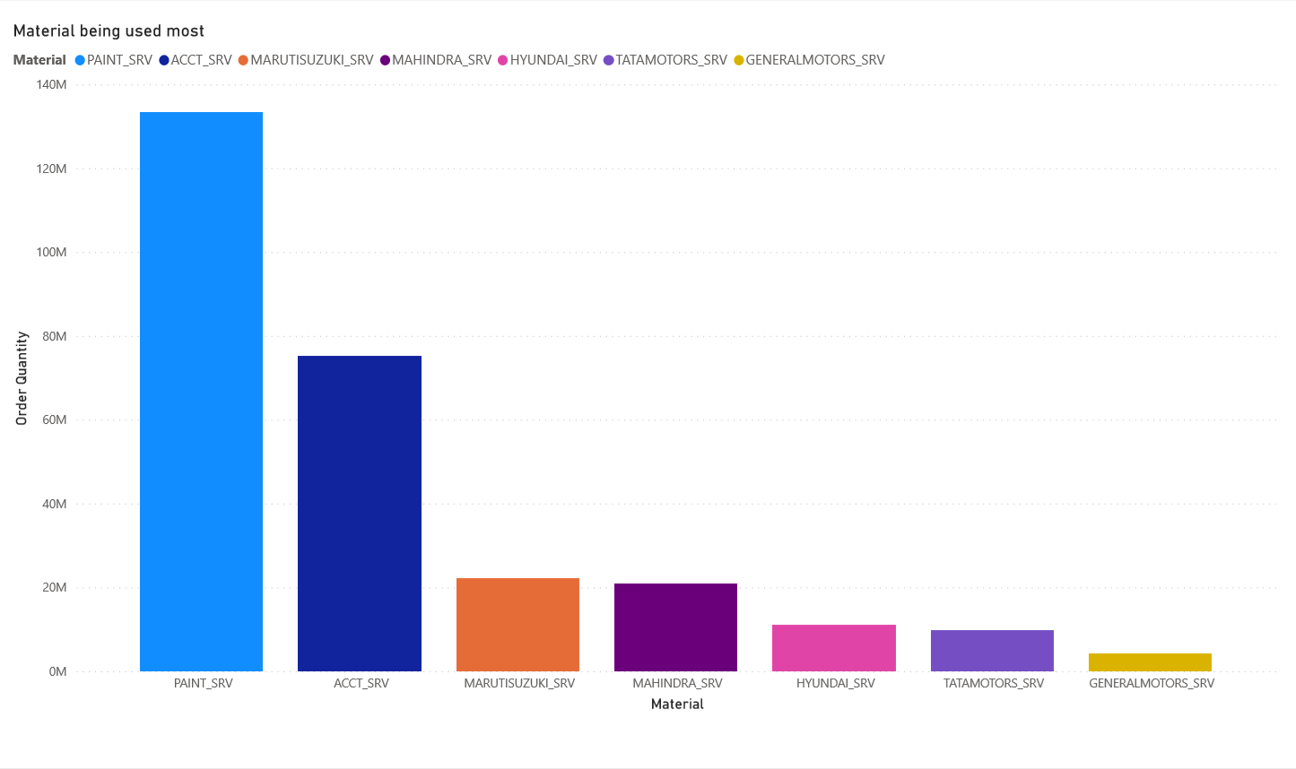
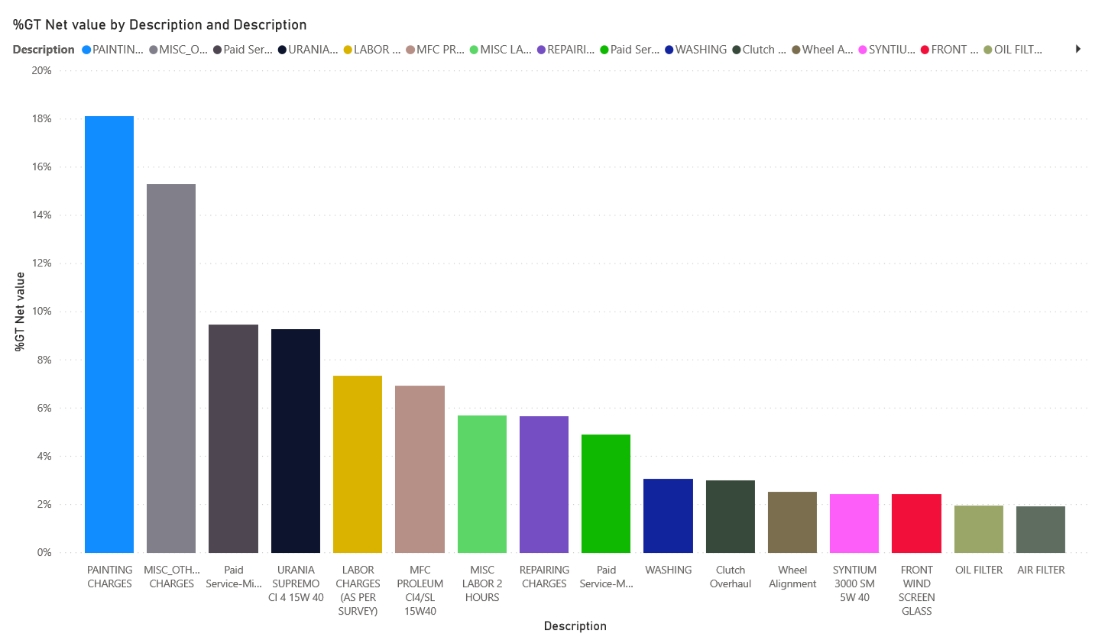
QN : Which inventory item is highly used?
Insight 1 : Painting, Washing is most preferred service , Their stock usage is more therefore their inventory should be maintained. Since most preferred so higher revenue from it is generated.
Note :- Running and Accidental Repair
Recommendation : Inventory of painting and washing should be maintained.

Slide 15
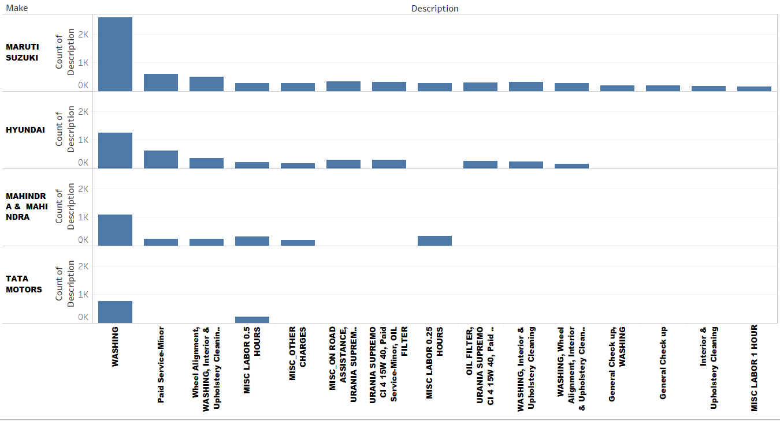
QN : Which service is most preferred in a particular make/car?
Insight 1 : Washing is most preferred in all the Make.

Slide 16
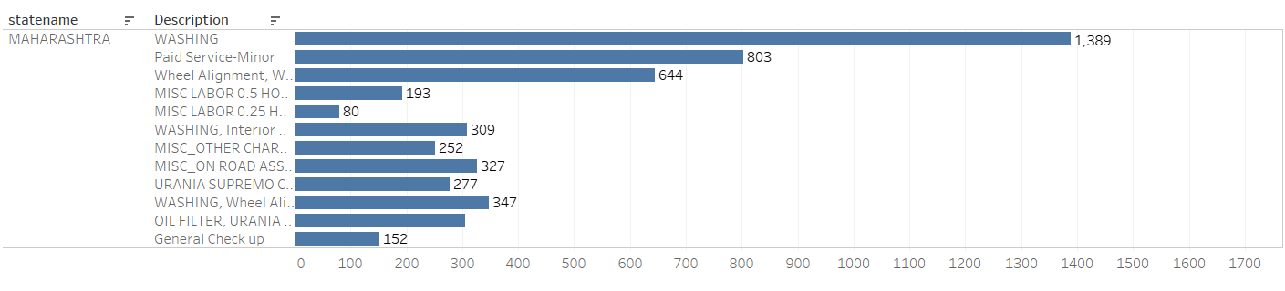
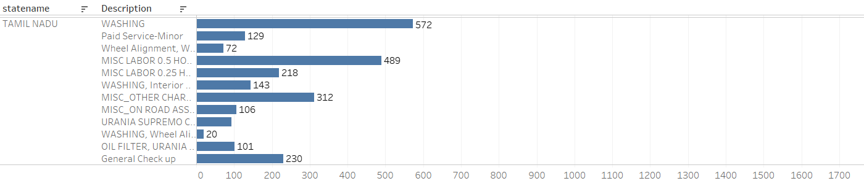
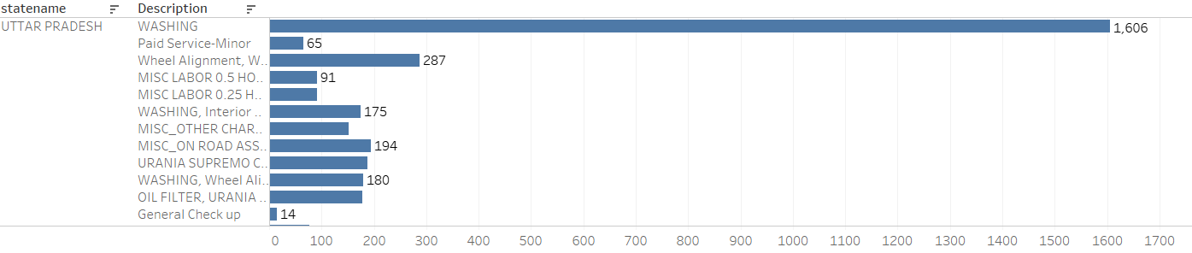
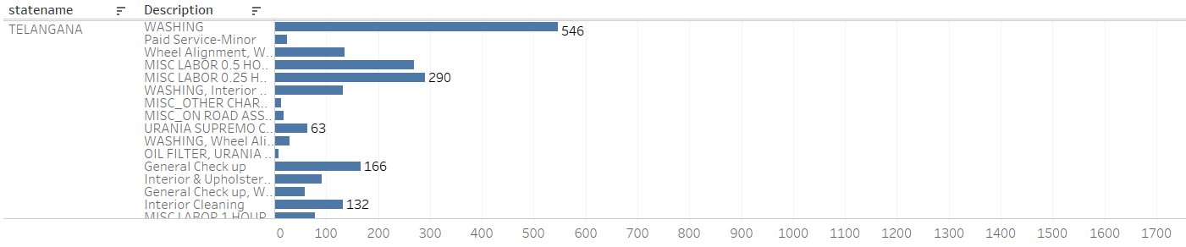
QN : Which state/area is the inventory in high demand?

Slide 17
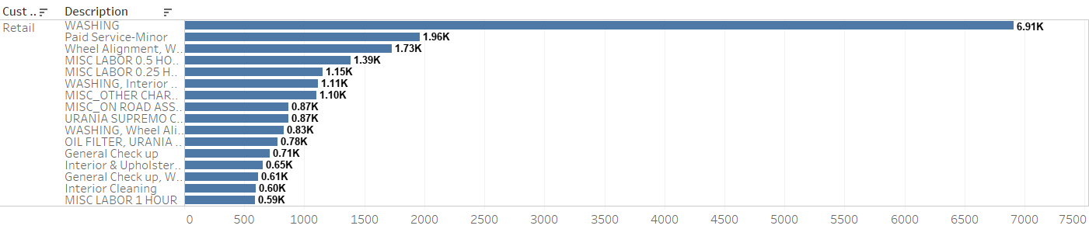
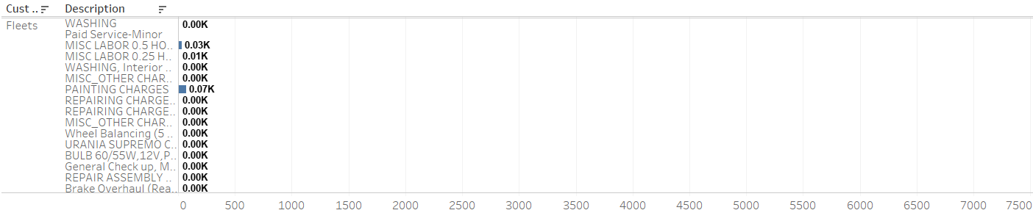
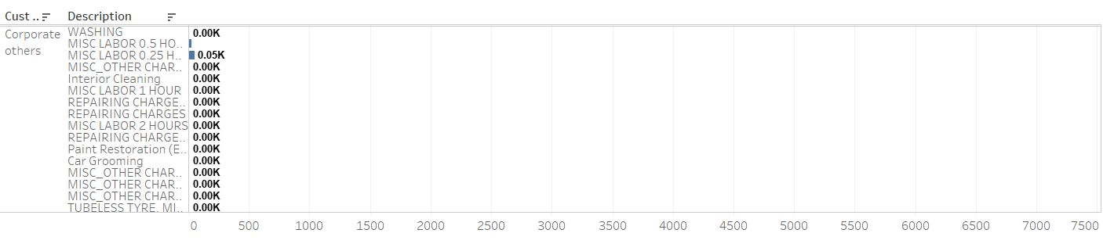
QN : Which category of customer is the inventory item required by?

Slide 18
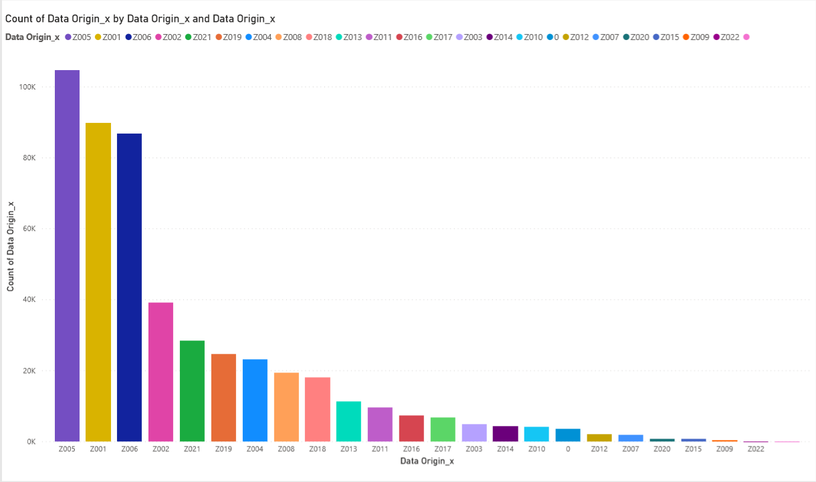
QN : Which marketing source is responsible in bringing which type of customer?
Insight 1 : Most of customer are from customer references.
Recommendation : We need to focus on attracting more customer using online social platform i.e. YouTube ,Facebook ,Tv , newspaper, Radio and pamphlet etc.

Slide 19
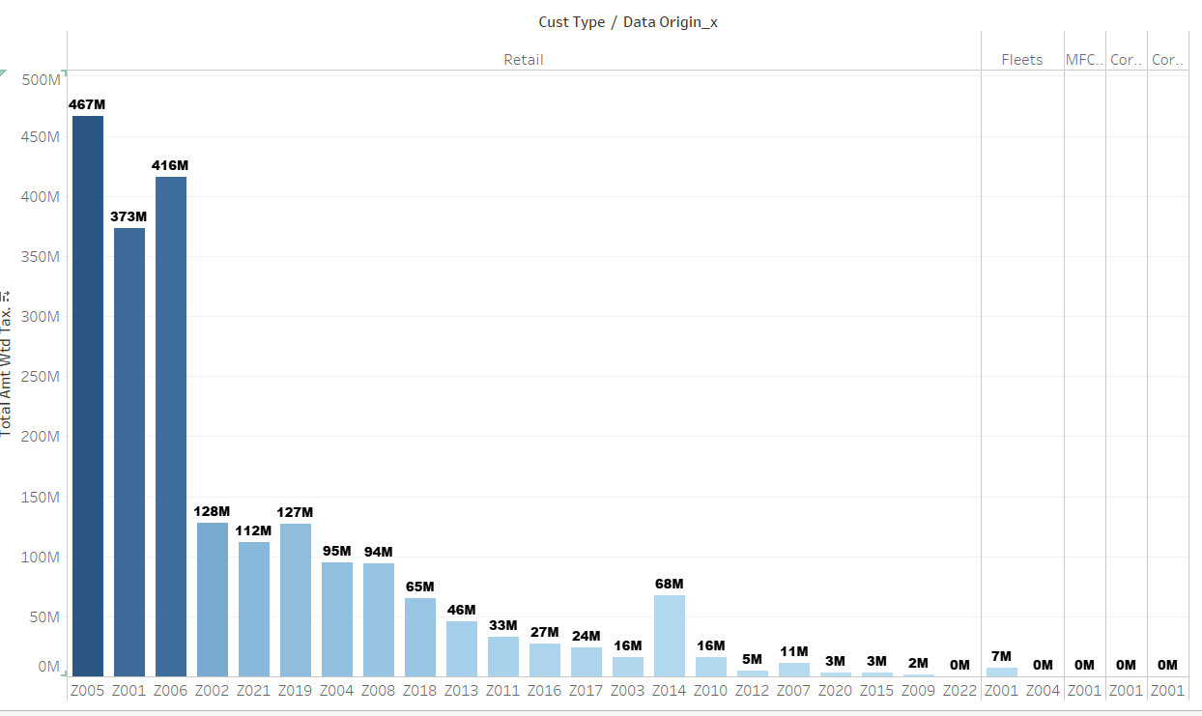
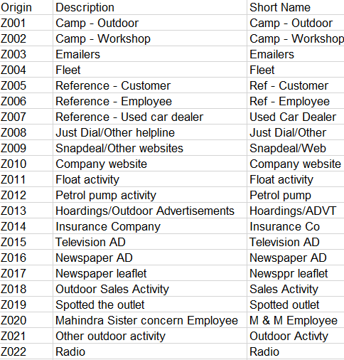
QN : Which marketing source brings the most business?
Recommendation : Provide complimentary service to the customer who provide more customer referral.
Out door camping should be increase in gas station.

Slide 20
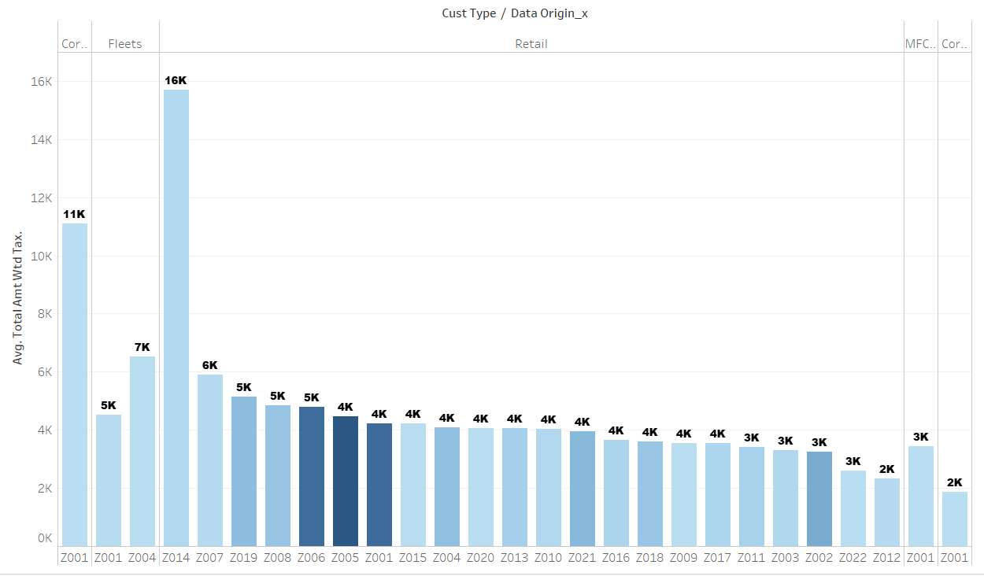
QN : What is the average income per source?
Insight : overall revenue of Retail Referral customer is more but average revenue of insurances is morw
Recommendation : Provide lucrative insurances services

Slide 21
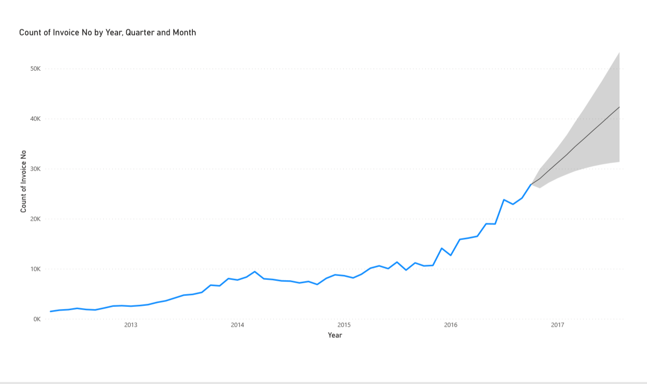
QN : How much business are to be expected in 2017?
As per the forecast the business would lie in the range of 31k to 53k.i.e business in 2016 q4 was around 27k(Invoices)

Slide 22
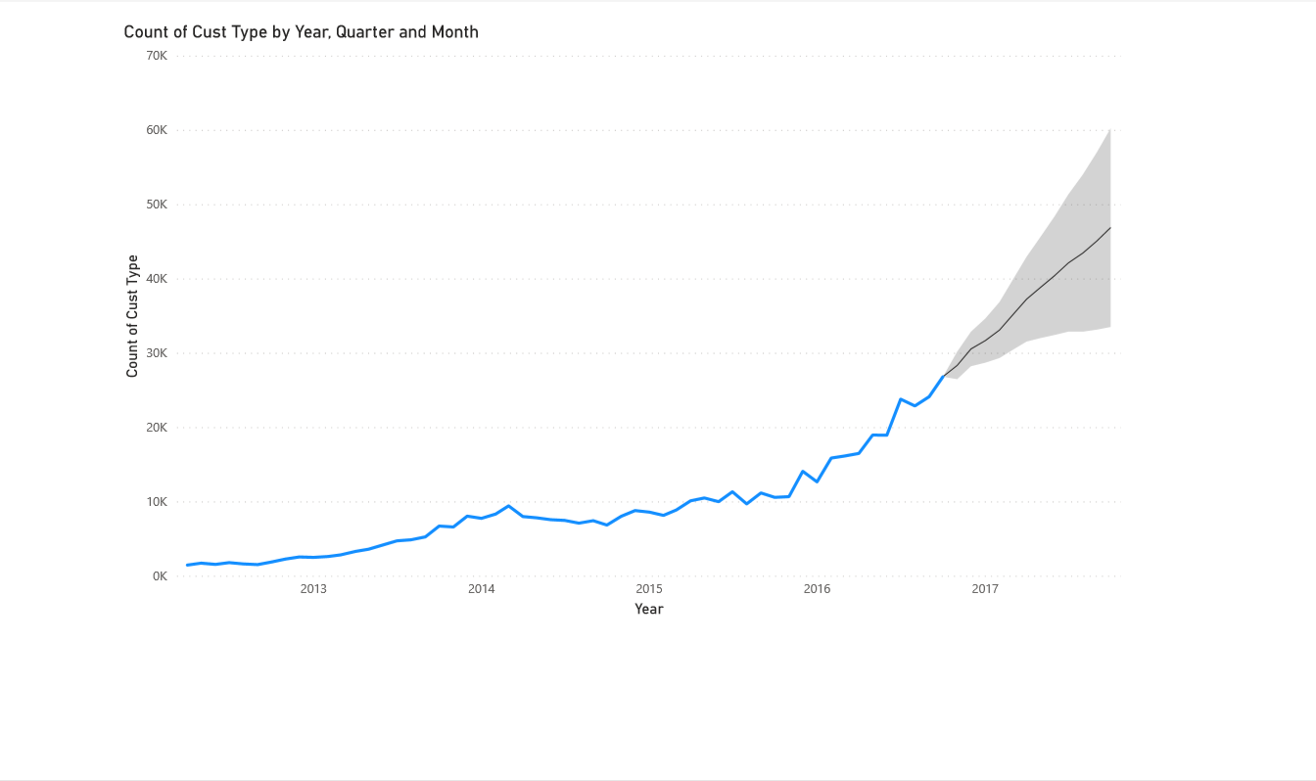
QN : What type of customers are to be expected?
As per the forecast the customers growth would lie in the range of 33k to 60k.i.e Customer in 2016 q4 was around 27k(Invoices)
As retain was the most dominating Customer Type amongst all.

Slide 23
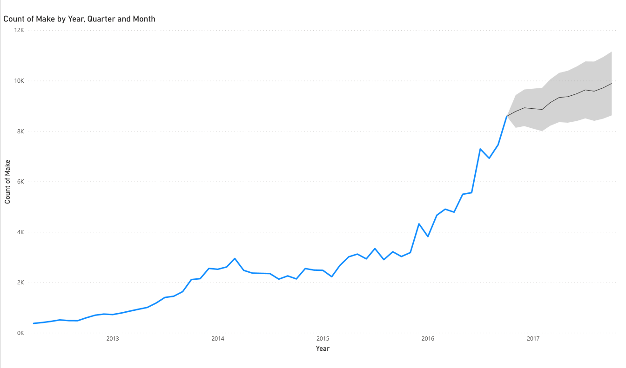
QN : Which make/car are to be expected the most?
As per the forecast the Make would lie in the range of 9k to 11k.i.e Count of Make in 2016 q4 was around 9k(Make)

Slide 24
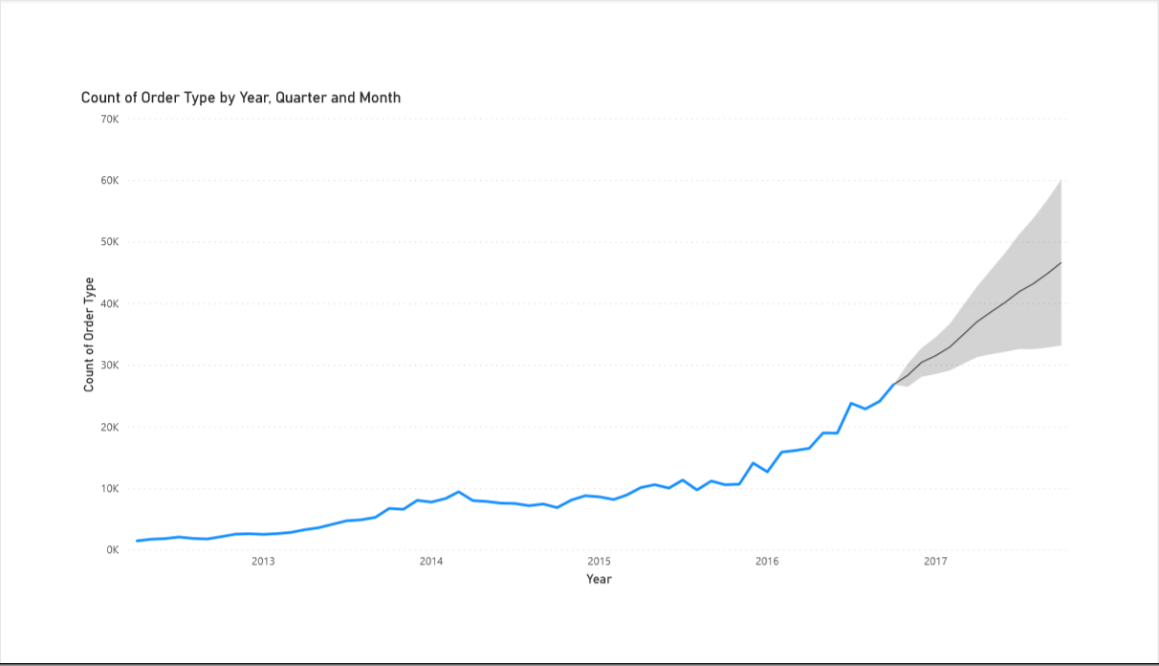
QN : What kind of services would be required the most?
As per the forecast the Service Type would lie in the range of 33k to 60k.i.e Services in 2016 q4 was around 27k(Services)

Slide 25
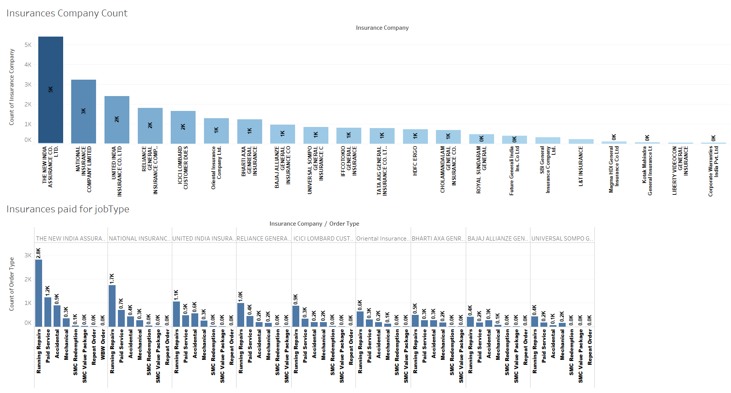
Insurance Company wise Analysis:
Recommendation : Insurances Company should consider more body part of car and provide better coverage.
Insurances must be included with MFCS package

Slide 26
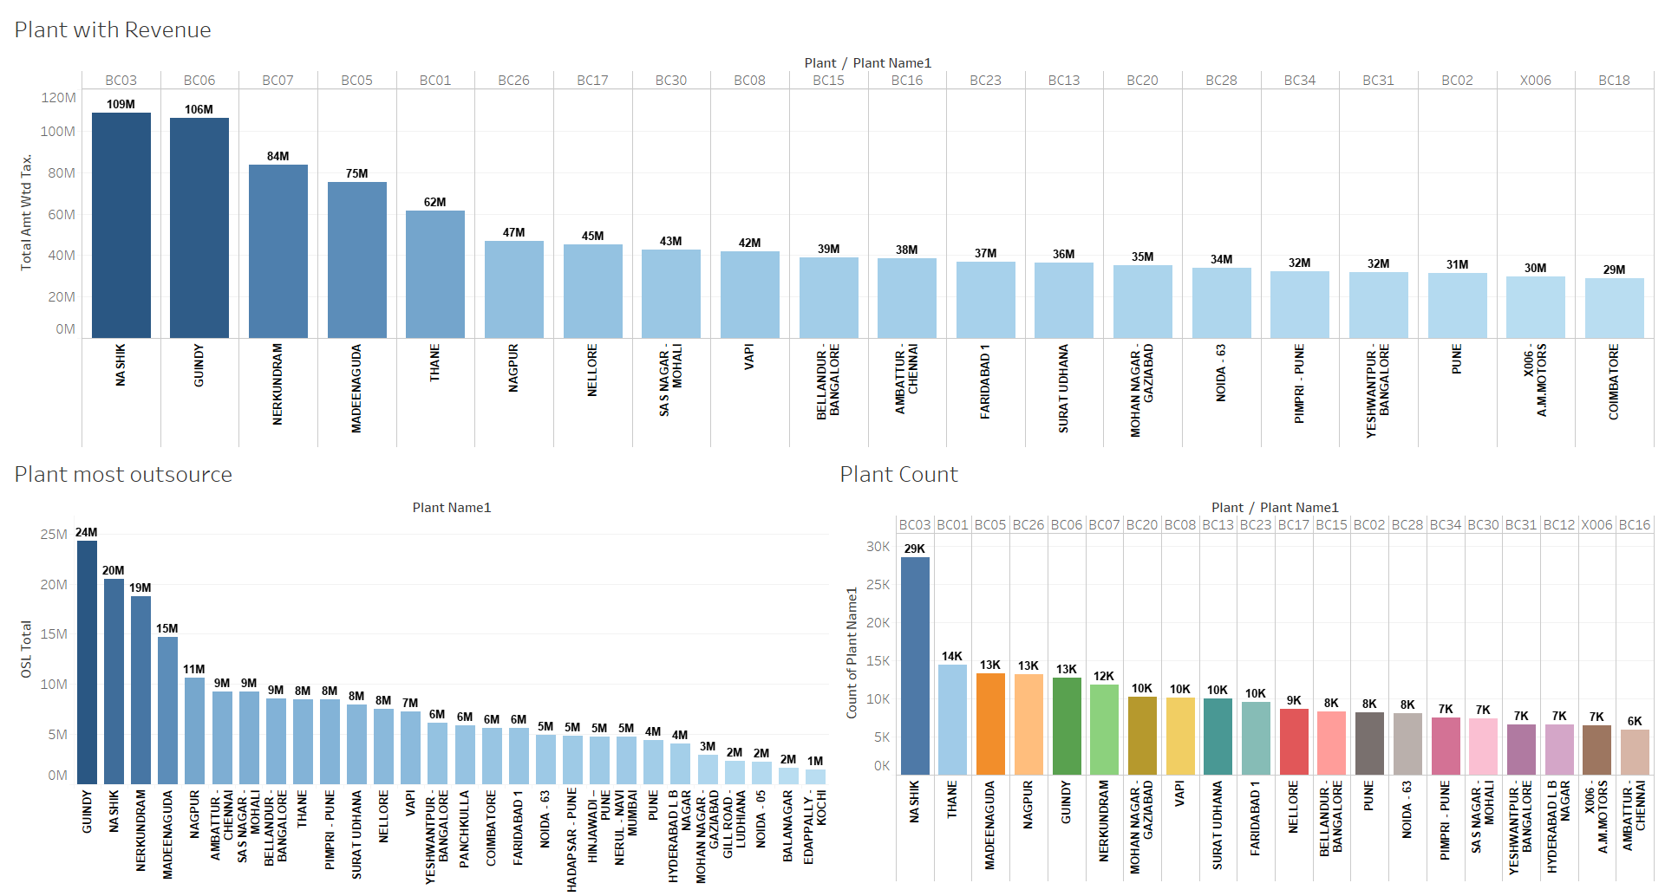
Plant Wise Business Analysis
Insight : Guindy and Nashik generating more revenues but at a same time out sourcing is more.
Recommendation : We need to hire skilled labour in such service station to reduce outsourcing.

Slide 27
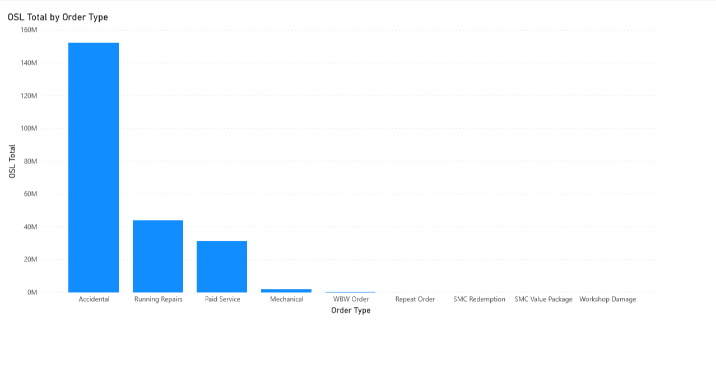
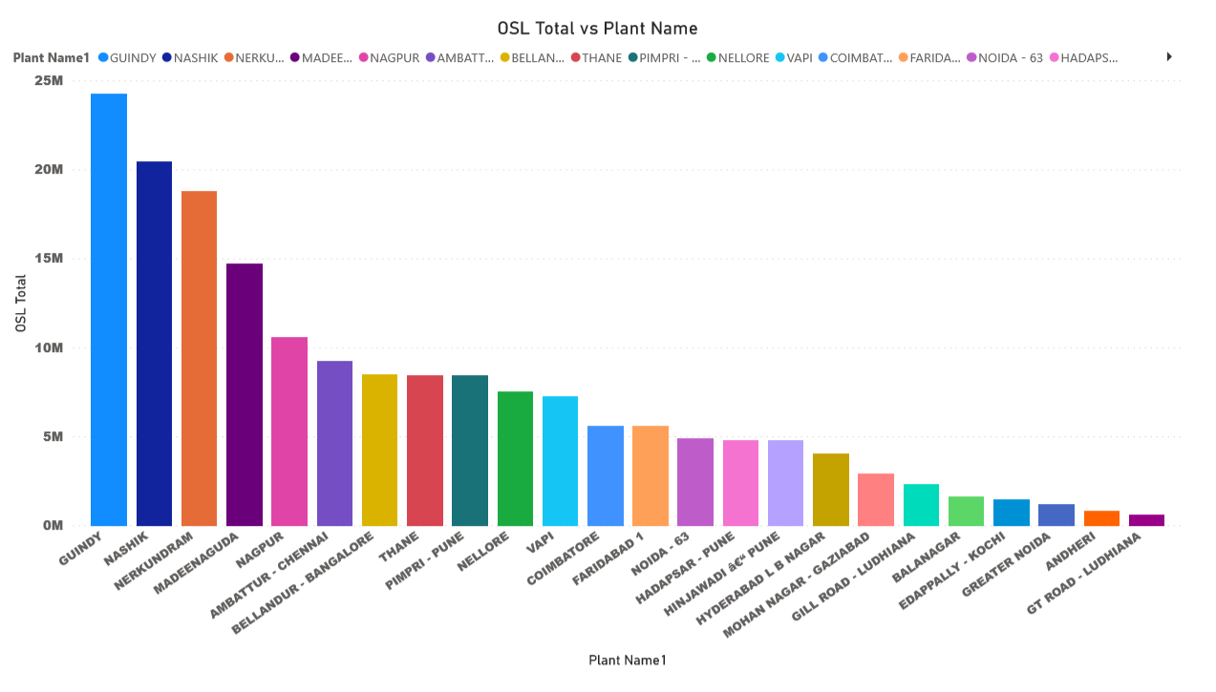
Which Service type and Plant Outsource the most?
Insight : Most of the accidental services are out sourced.
Recommendation : Training should be provided to employee to reduce out sourcing or hire skilled labour.
Inventory should be available for accidental services.

Slide 28
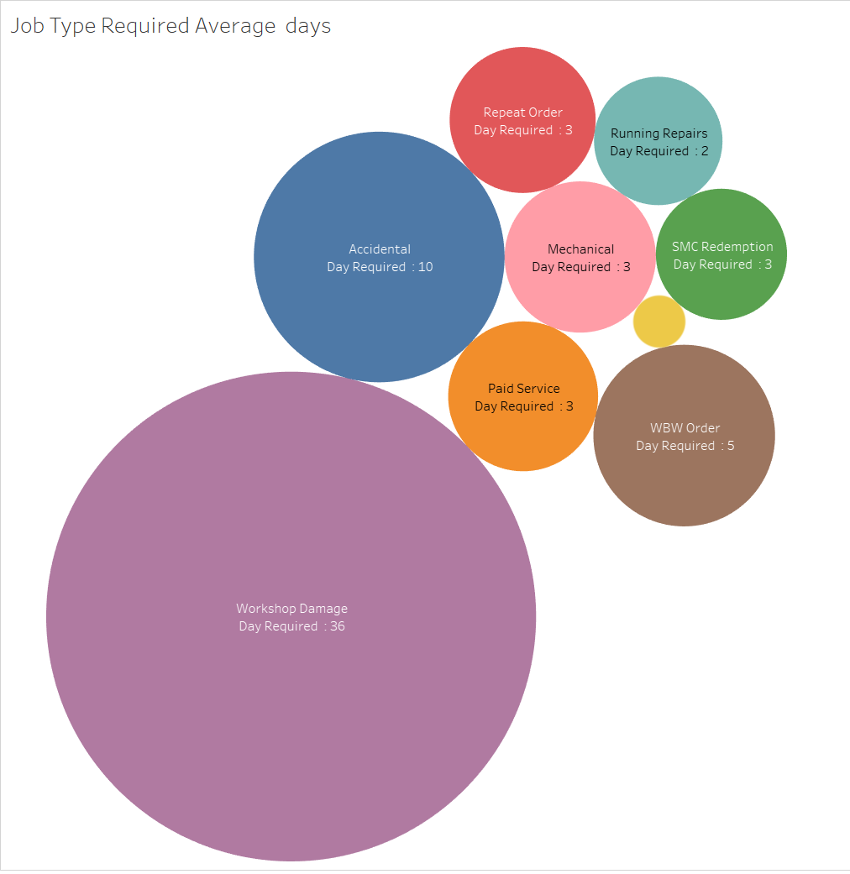
Analysis : Average day taken for each services
Insight : Workshop damage requires the maximum days on an average is 36

Slide 29
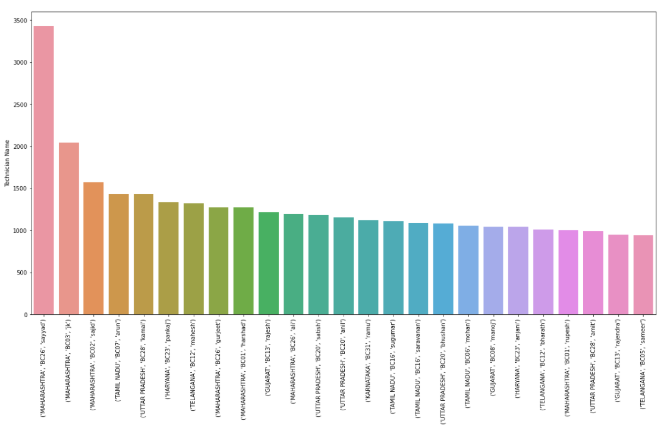
Top Efficient Technician :
Insight : Sayyad ,JK and Sajid are the top 3 Technician which resolve most of the car issues who are from Maharashtra.
Skilled technicians from Maharashtra and Tamil Nadu can be sent to low skill area i.e. North,East.

Slide 30
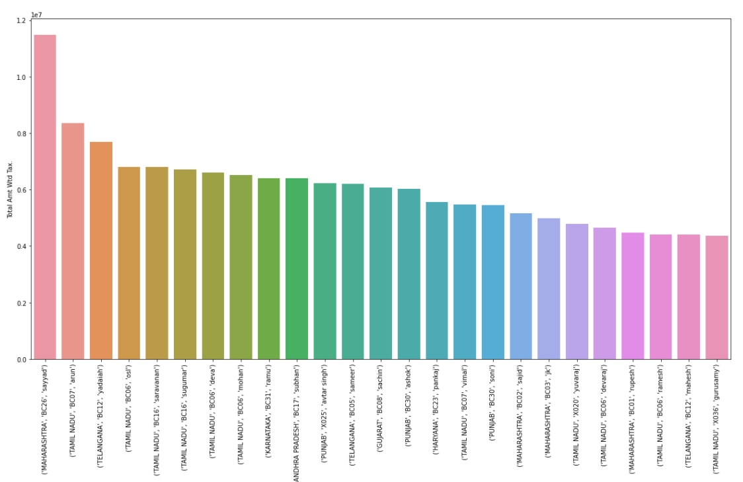
QN : Technician who generate more Revenue
Insight : Sayyad, Arun and Yaidaiah are the top 3 technician who are regenerating more Revenue

Slide 31
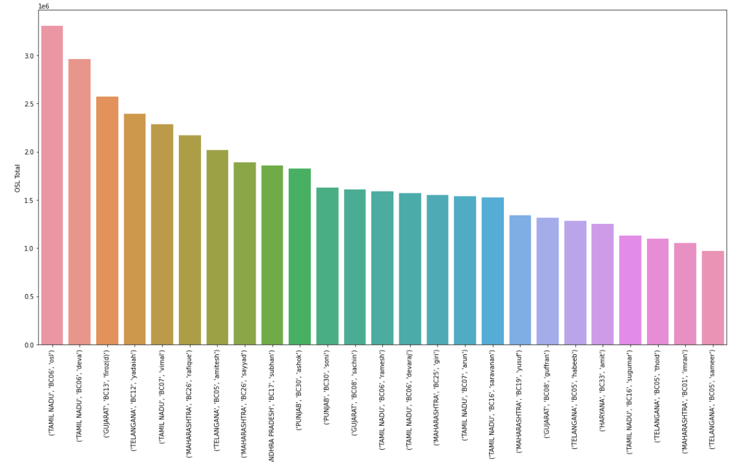
QN : Technicians Who are Outsourced the most
Insight : Technician Deva, Firoz and yaidaiah are the 3 top out sourced Technician

Slide 32
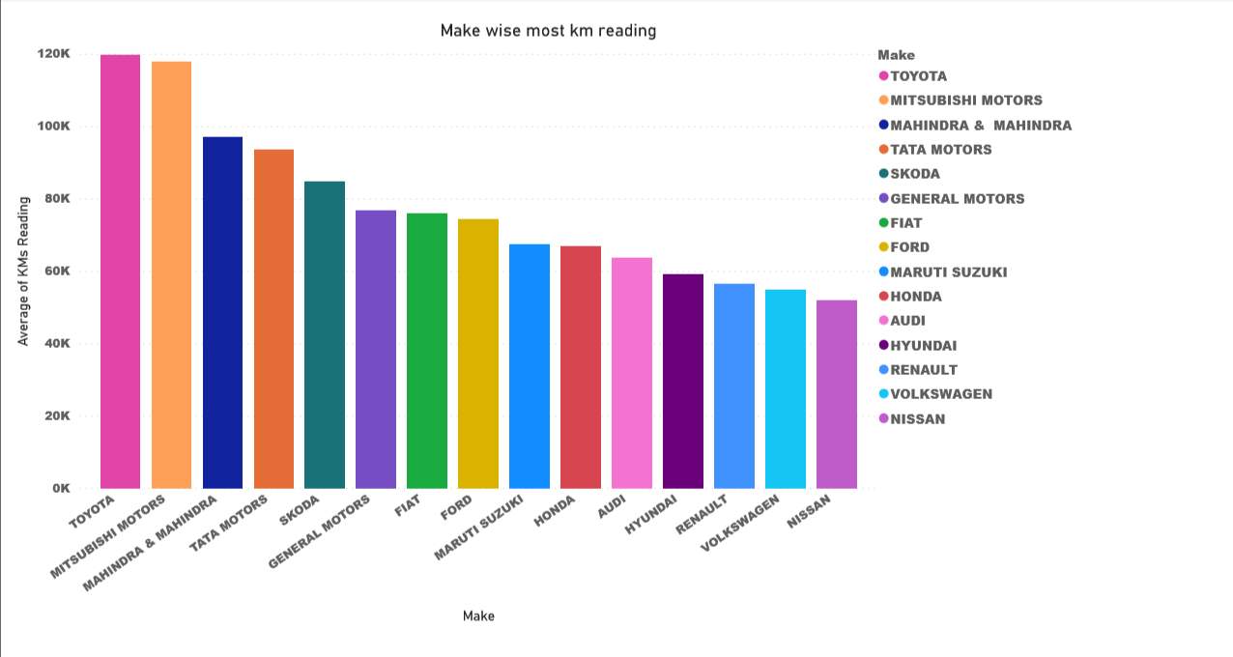
Insight : Maruti is dominant in all factor but strangely Toyota, Mitsubishi, Mahindra. Etc(SUV) are having most avg kms.

Slide 33
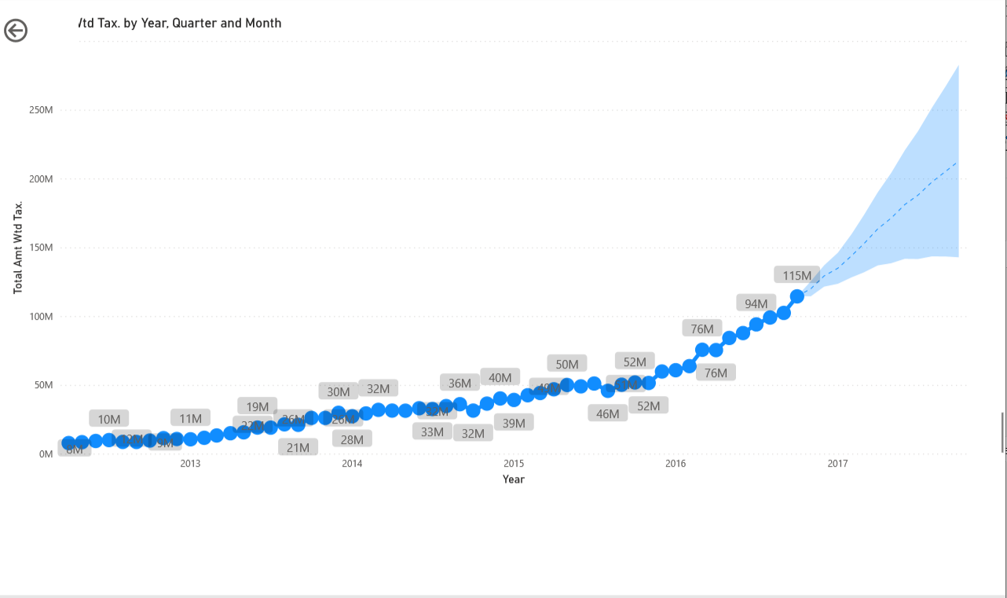
Revenue wise Forecasting Every Year.
Forecast would be around 120M in Q1 in 2017 and 213M in Q4 in 2017 as per the Forecast.

Slide 34
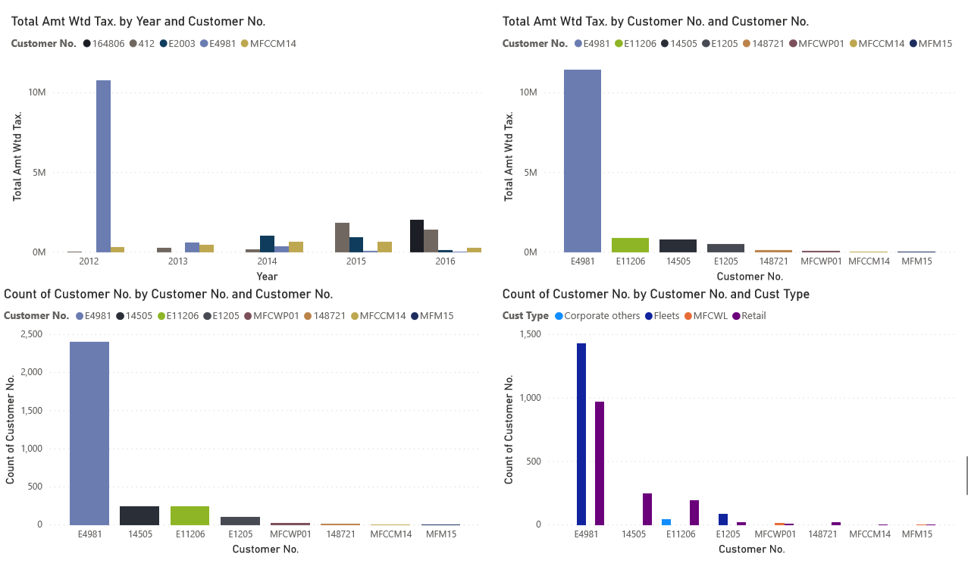
- E4981 was the most repeated customer in 2012 but strangley as per the year analysis it decreased.
- Some customer was not satisfied with services that’s why we see the drop in every factors.

Slide 35
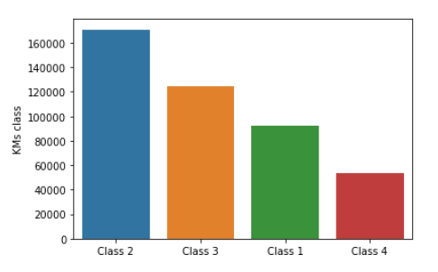
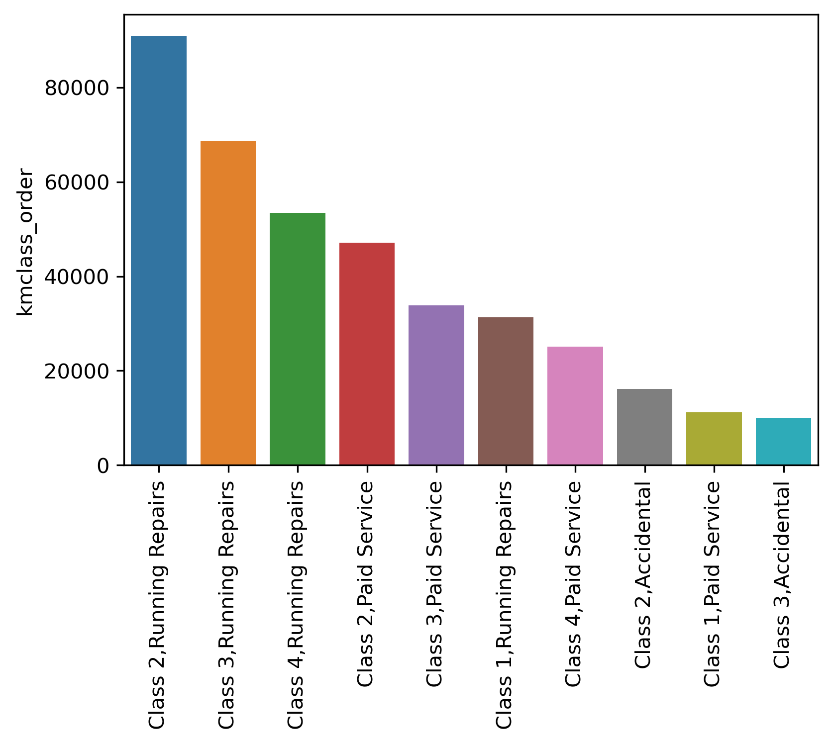
Insight : For class 2 ,class 3 and class 4 vehicles Running repairs and paid services are frequently required
Class 1 < 20k
Class 2 20k < 60k
Class 3 60k < 100k
Class 4 100< 160k

Slide 36
Cluster Analysis
Cohort Analysis.
Market Segmentation using RFMT Technique.
Clustering as per Make / Services.

Slide 37
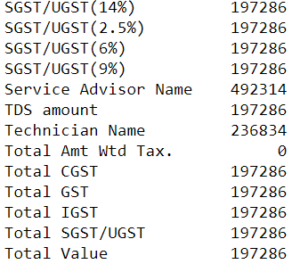
Pre-processing Steps
Treatment of Null Values.
Neglecting ‘0’ from ‘Total Amount wtd Tax’.
Created feature average time which is Job card date minus Invoice date .

Slide 38
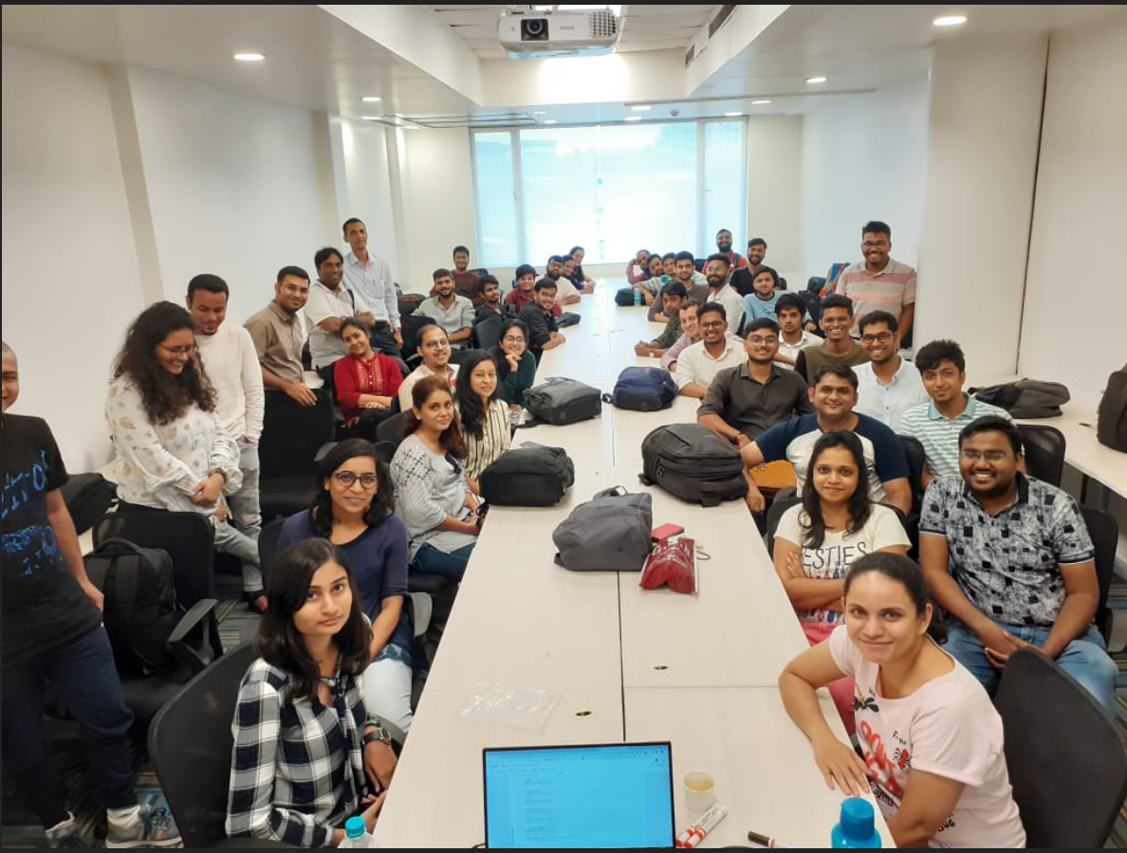
Cohort Analysis
In the context of business analytics, a cohort usually refers to a subset of users specifically segmented by acquisition date (i.e. the first time a user visits in MFCS).
A “cohort analysis,” then, simply allows you to compare the behavior and metrics of different cohorts over time. You can then find the highest-performing (or lowest-performing) cohorts, and what factors are driving this performance.
Sept 15 Cohort

Slide 39

Steps for Cohort Analysis
Creation of ‘cohort_month’ feature.
Creation of ‘cohort_index’ feature.
Creation of cohort matrix = cohort month * cohort index (55x55)i.e Retention rate.

Slide 40

Calculation of Retented Customer

Slide 41

Calculation of Revenue from Retented Customer

Slide 42
RFMT Analysis
Creation of Recency feature(Max invoice date - Latest invoice date) were taken).
Creation of Frequency feature(Unique counts of invoice were taken customer wise).
Creation of Monetary feature(Sum of ‘Total Amount wtd Tax’ were taken customer wise).
Creation of Tenure feature(Max invoice date -1st invoice date) were taken).

Slide 43

Glimpse of RFMT Table

Slide 44

Division of RFMT features in quantiles
And calculating RFMT score on the basis of RFMT segments.

Slide 45


Best Customers and overall mean of RFMT

Slide 46



Customer Segmentation according to Tier

Slide 47

RFMT analysis General Segment wise

Slide 48


Recency Analysis
Recommendation : To improve recency we need to have strong customer care support to provide a reminder for last service date and car health with respect last date.

Slide 49


Frequency Analysis
Insight : Frequency is very less and on an average 2 days which means that customer visits are smaller service.
Recommendation : MFSC should also focus on smaller services or provide annual subscription

Slide 50


Monetary Analysis
Insight : On an average customer spend 9k and one customer had spend upto 50Lakhs
Recommendation : Technician should provide more recommendation of body part which are on the verge of breakdown.
Advertainment near Highway for accidental cases and provide Toll free number.
24 Hours Service Facilities
Need to focus on premium cars

Slide 51


Tenure Analysis
Insight : Majority of the customer have tenure of 1 Days.
There are very few customer which have larger tenure days

Slide 52




Normalization of RFMT

Slide 53

Cluster selection and processing
cluster 3: These customers are loyal to MFSC ,their frequency is also good hence revenue they give is also high.
cluster 2: They have been associated with MFSC for a good period of time but the revenue generated from them is less as compared to cluster 3 which means they might not be opting for all the services at MFSC, even they have not been recent.(from marketing point of view they need to be focused with respect to some lucrative offers)
cluster 0: These are our rarely visiting customers, less frequent, associated with MFSC for less period of time and so revenue we get from them is lesser.( not to focus w.r.t marketing right now)
cluster 1 : these customers are new customers of MFSC and show good potential. they need to b converted to loyal ones
cluster 4: has been spending less .he should be made aware of premium services provided by MFSC.

Slide 54



Clustering with make model and order type
Cluster with make, Model and order type after PCA
Cluster with make vs Total amount

Slide 55

Clustering with Make

Slide 56

Clustering with order type

Slide 57


CLV prediction with make model( Classification & Regression )

Slide 58





DecisionTreeRegressor
DecisionTreeClassifier
Model is overfitted

Slide 59



CLV prediction with cohort analysis and Linear Regression

Slide 60

The Model Tracks only 37% variances.

Slide 61

CLV prediction with BG-NBD model

Slide 62



Slide 63



Slide 64



Slide 65



Slide 66


Data Frame After applying gamma gamma fitter.
CLV prediction using Life time package.

Slide 67



CLV prediction using XGB model

Slide 68
Conclusion
MFSC runs a common business Example :
Majority customer comes from references
Majority cars are Maruti
Majority services are Running repair
Solution :
Inventory Management and Recommendation
Quarterly maintenances plants and inventory should be maintain for frequent services.
Best Service in case of accident (Car body repair kit should be Stocked i.e. paint ,dumper , headlight ).
Current generation prefer high end accessories (i.e. reverse camera, sensor, ABS and security and safety acc.)
Marketing Recommendation
MFSC should focus on online advertisement i.e. Facebook page, Tv, radio and Pamphlet
Post service feedback calls.
Monitor the performances of Franchise and Reward them.
Participation in Auto Expo
24*7 Highway assistant for running and accidental repair.
Token of appreciation to our loyal customer in terms of free services.
Express service centre (quick service station) typically located at petrol pump which provides simple servicing.
Various insurances assistance even in case of running repair.

Slide 69
Conclusion
MFSC should focus on metropolitan area and premium car servicing at competitive price.
Economical Vehicle inspection package(i.e. Wheel alignment and Balancing, Interior , Panel Denting and Painting, Anti-rust treatment, General check-up and more).
WBW(Warranty beyond Warranty) should be more recommended to second hand car and older car customer.
Providing workshop events for Corporates.
Skill technician will educate the customer about the basic servicing and to fix minor problem in your car.
Technician Training centre should be made available to upskill technician.
Customer Prediction :
Customer can be cluster in platinum ,gold , silver and Bronze.
Revenues prediction and retention rate .
CLV calculation should not be done in a traditional manner it should be more of a business specific parameter considering discount and customer course.

Slide 70

Thankyou All for being the part of our learning journey
Special Thanks to cohort Mentor : Rushikesh
Hackathon Mentor : Dileep & Amitansh

Slide 71

Team GreyElectron

